Slide 1
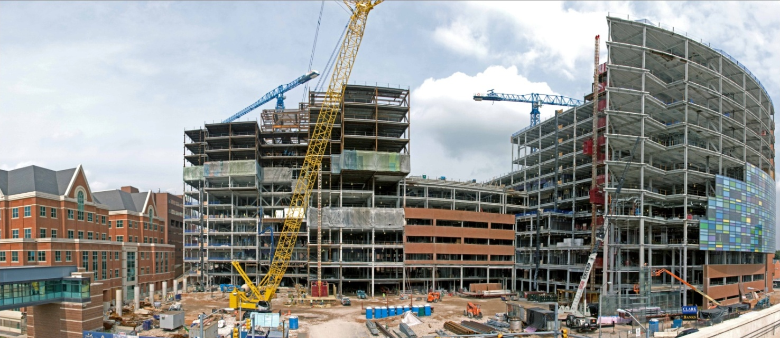
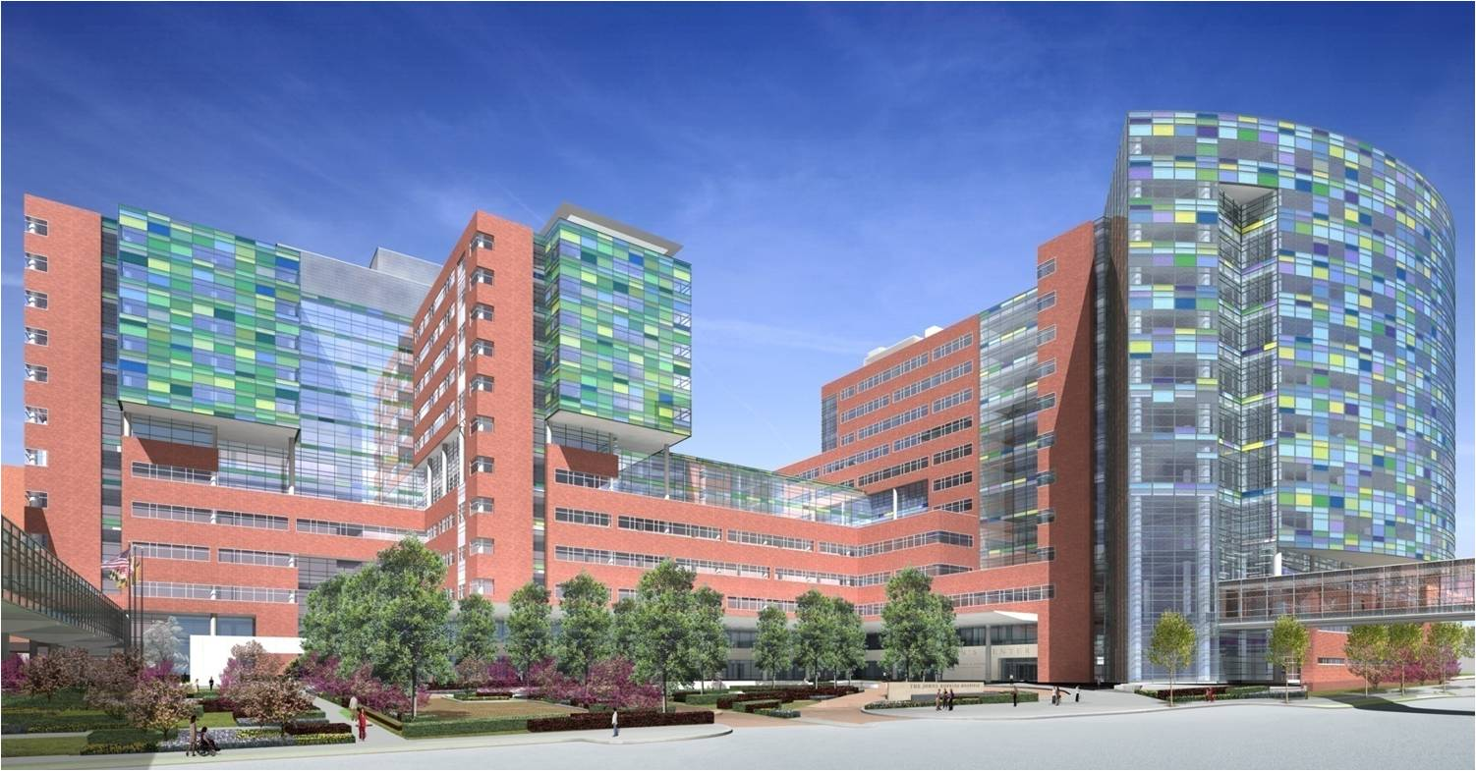
Construction Progress in October 2008

Slide 2
Introduction
Project Background
Research Focus
Alternative Delivery Method (MAE)
Chilled Beam Cost & Schedule Impact (Mech. Breadth)
Case Study: Concrete Over-pour on Decks Due to Steel Deflection (Structural Breadth)
Thesis Conclusions
Acknowledgements
Questions???

Slide 3
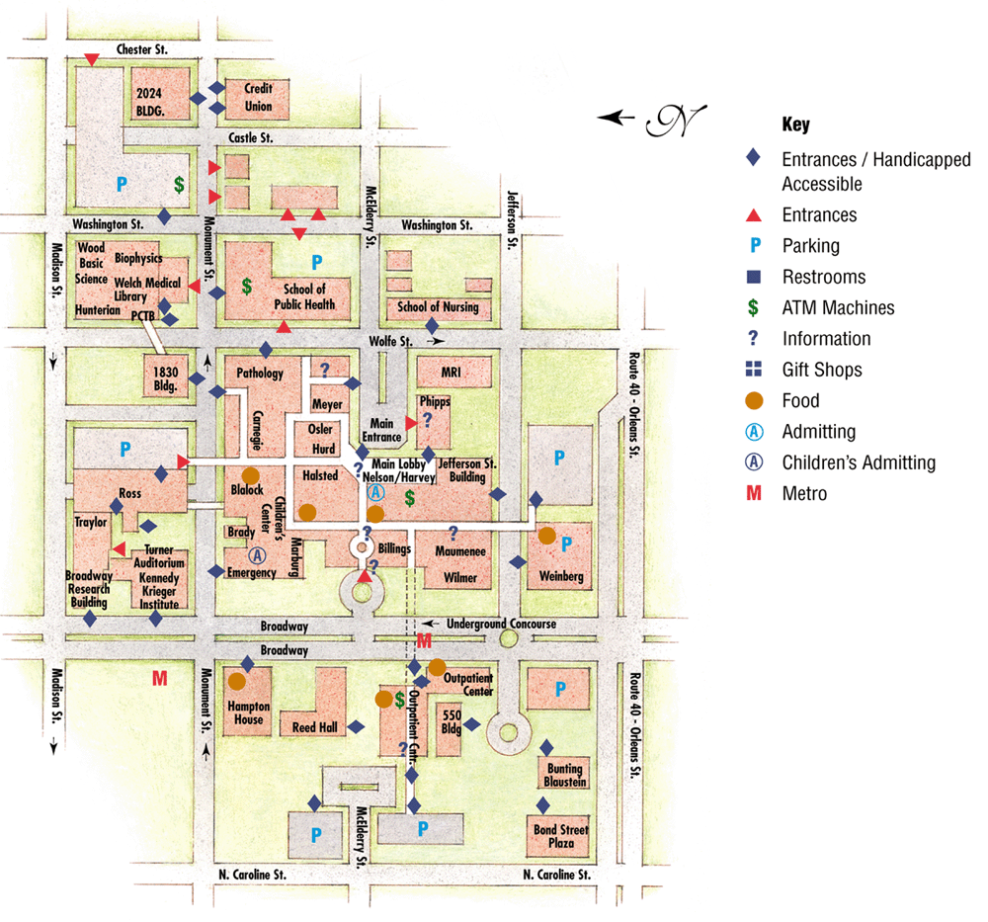
Project Background
Johns Hopkins Hospital
  Ranked #1 Hospital since 1992 by U.S. News & World Report
  Annual Operating Budget = $4.1 Billion (2007)
  82,523 Admissions, 72,797 Surgeries, 205,034 ER Visits
  4.2 Million Square Feet of Building Space
New Clinical Building

Slide 4
Project Background
Johns Hopkins Hospital
  Ranked #1 Hospital since 1992 by U.S. News & World Report
  Annual Operating Budget = $4.1 Billion (2007)
  82,523 Admissions, 72,797 Surgeries, 205,034 ER Visits
  4.2 Million Square Feet of Building Space
Children’s Tower
Adult Tower
New Clinical Building
  Two Towers – Adult and Children’s with Connector
  1.6 Million SF
  $573 Million GMP
  Oct. 2006 – Dec. 2010
  Design-Bid-Build, Fast-track schedule
  Surrounded by operating hospitals throughout construction
Connector

Slide 5
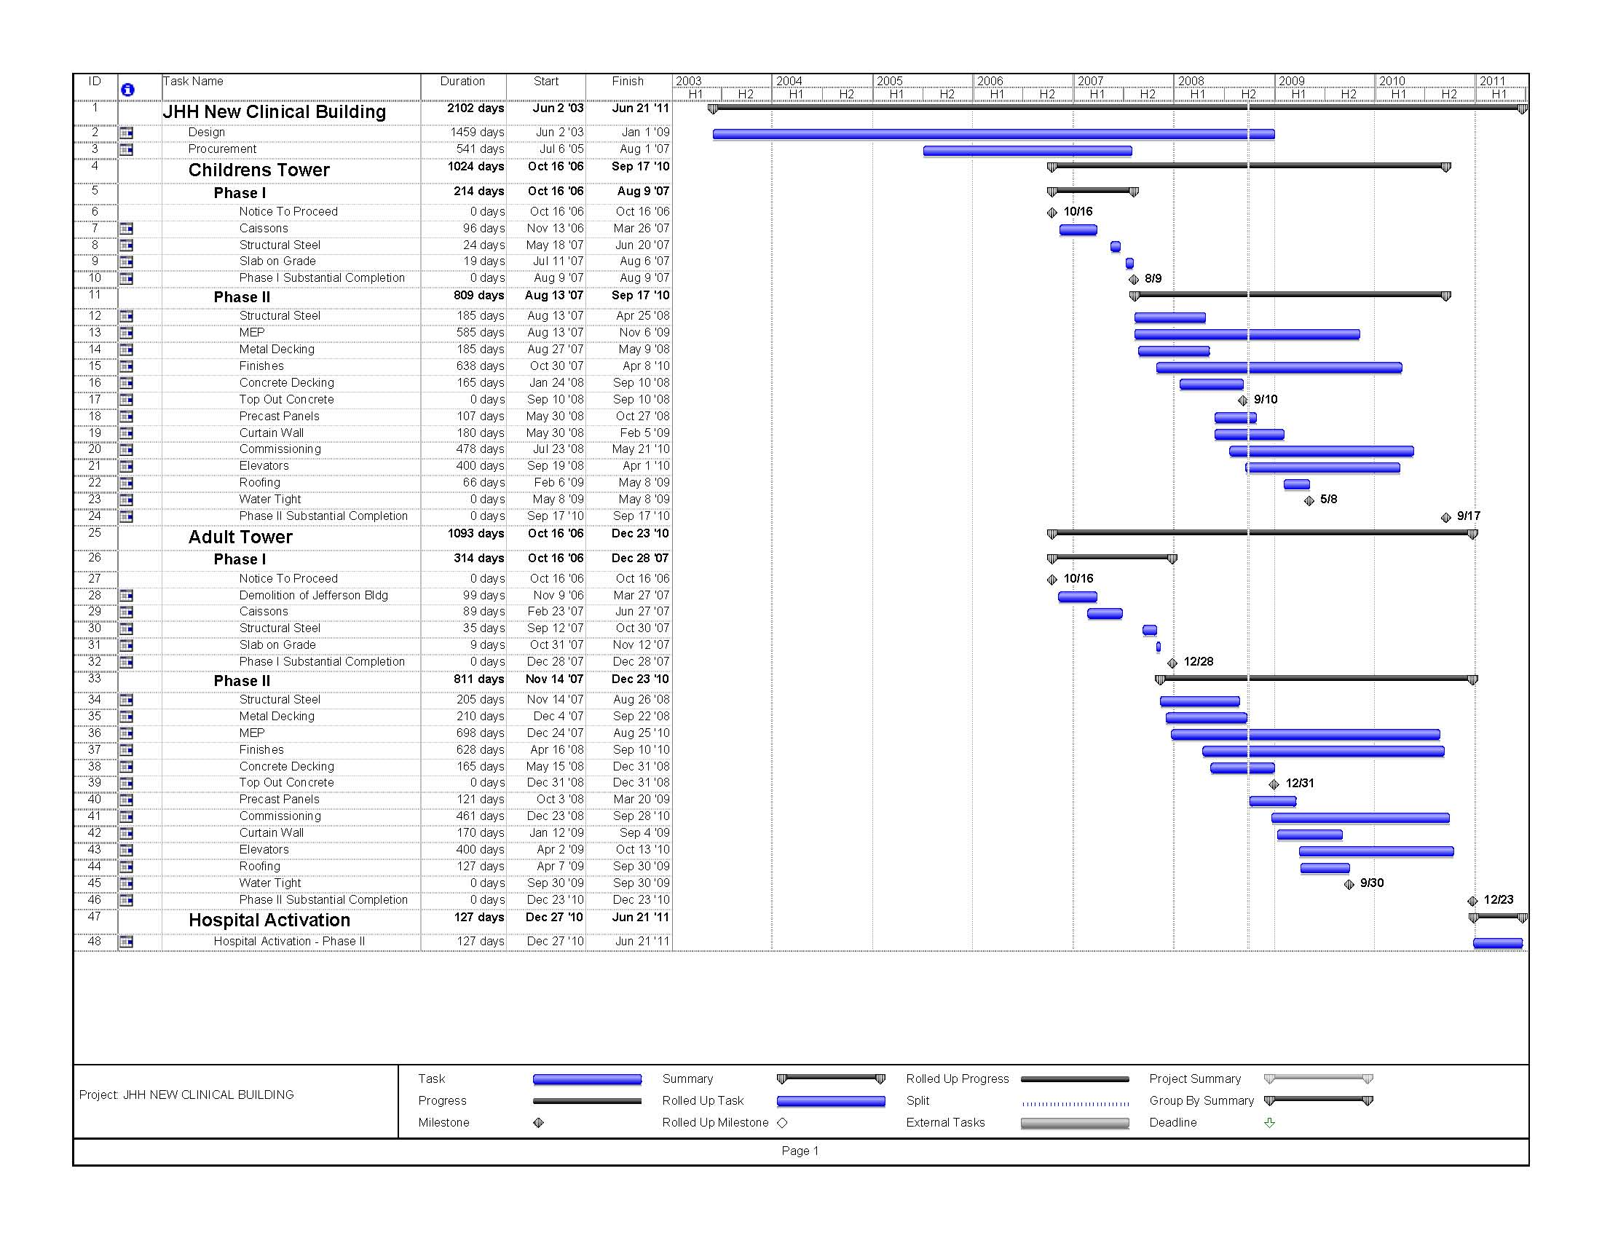
Project Background
Johns Hopkins Hospital
  Ranked #1 Hospital since 1992 by U.S. News & World Report
  Annual Operating Budget = $4.1 Billion (2007)
  82,523 Admissions, 72,797 Surgeries, 205,034 ER Visits
  4.2 Million Square Feet of Building Space
New Clinical Building
  Two Towers – Adult and Children’s with Connector
  1.6 Million SF
  $573 Million GMP
  Oct. 2006 – Dec. 2010
  Design-Bid-Build, Fast-track schedule
  Surrounded by operating hospitals throughout construction

Slide 6
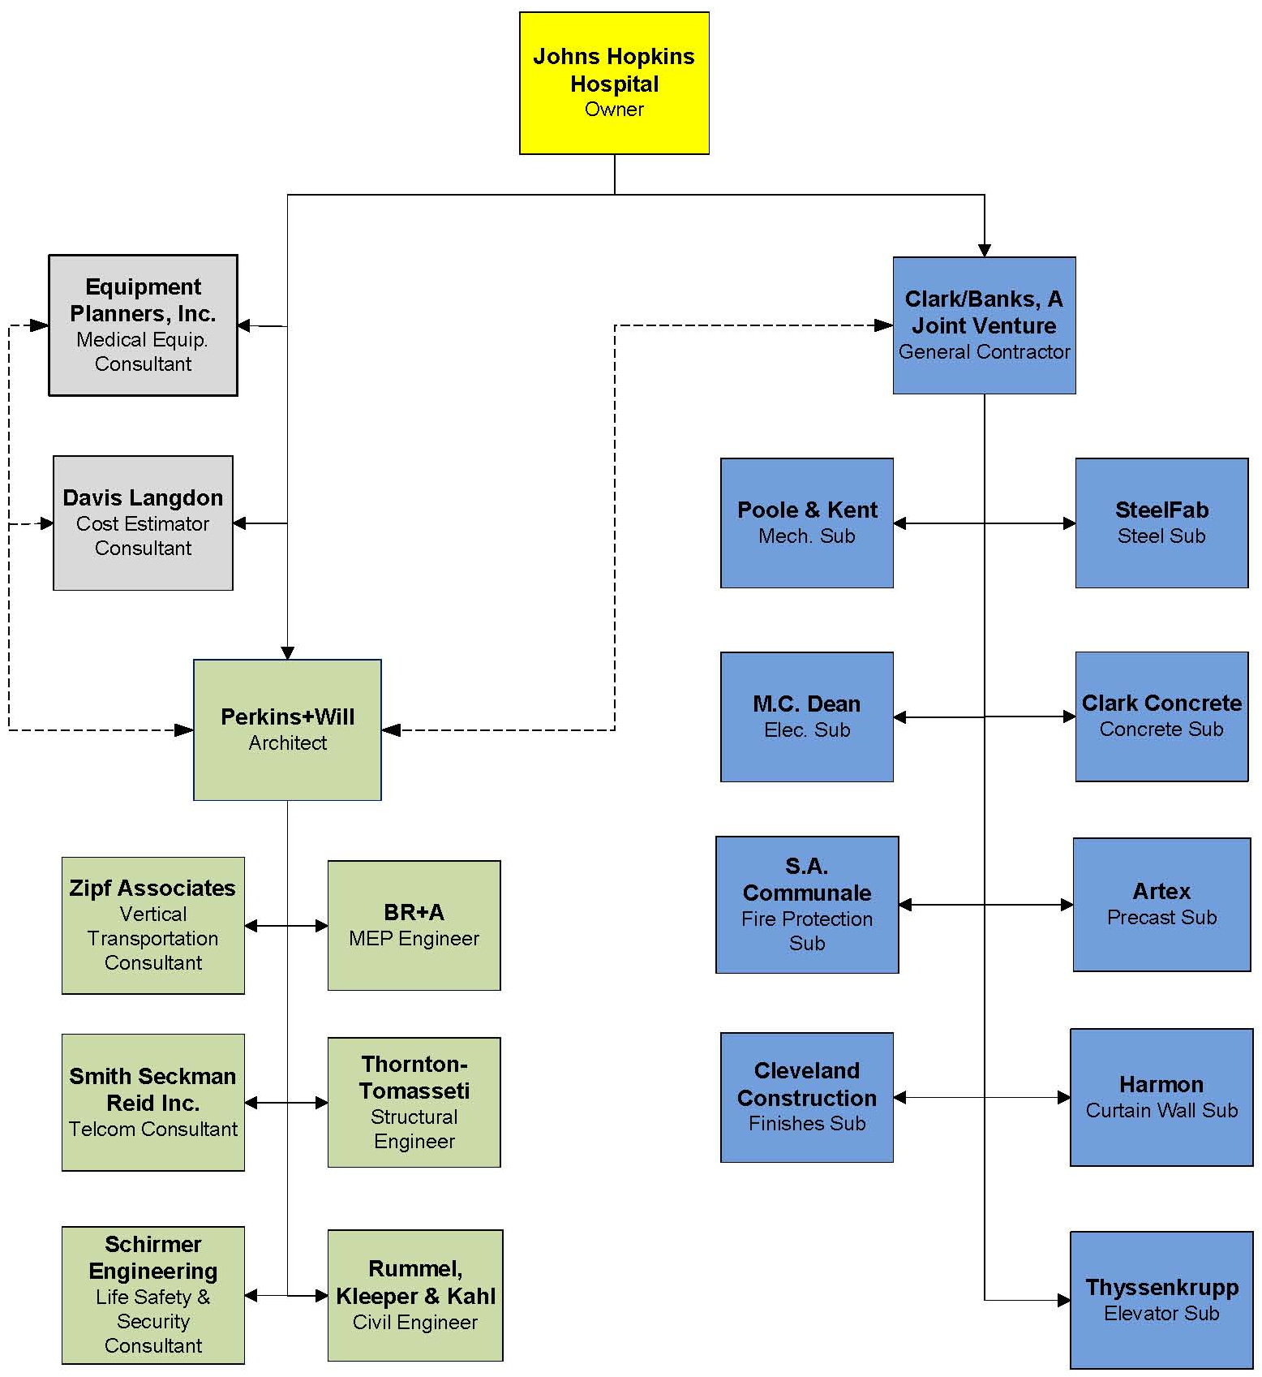
Project Background
Johns Hopkins Hospital
  Ranked #1 Hospital since 1992 by U.S. News & World Report
  Annual Operating Budget = $4.1 Billion (2007)
  82,523 Admissions, 72,797 Surgeries, 205,034 ER Visits
  4.2 Million Square Feet of Building Space
New Clinical Building
  Two Towers – Adult and Children’s with Connector
  1.6 Million SF
  $573 Million GMP
  Oct. 2006 – Dec. 2010
  Design-Bid-Build, Fast-track schedule
  Surrounded by operating hospitals throughout construction

Slide 7
Research Focus
“Explore alternatives and procedures that could have been implemented on the NCB to avoid or reduce the number of changes and constructability challenges.”
WEIGHT MATRIX
Description | Research | Value Engineering | Constructability Review | Schedule Reduction | Total
Alter. Delivery Method | 20% | 5% |  | 10% | 35%
Chilled Beams | 10% | 10% | 5% | 15% | 40%
Conc. Over-pour on Decks |  |  | 25% |  | 25%
Total | 30% | 15% | 30% | 25% | 100%

Slide 8
Alternative Delivery Method (MAE)
Problem Statement
  Traditional Design-bid-build with Fast-track
  60 CCD’s
  2,700 RFI’s
  700 CO’s
    Design Omissions/Errors
    Donor Enhancements
    Latest & Greatest Medical Technology
  Cost Increase = $250 M (44%)
  7 Month Delay (1st pass)
  Bid was done with GMP Docs
    CD’s Due April 2007
    Issued 2 Floors per Month
    Final Set Arrived January 2009

Slide 9
Alternative Delivery Method (MAE)
Goal
  Demonstrate that an alternative delivery method could have more effectively managed the changes while meeting the Owner’s goals.

Slide 10
Alternative Delivery Method (MAE)
Possible Project Delivery Outcomes
Traditional Design-bid-build
Traditional with Early Procurement
Traditional with Project Manager
Traditional with Construction Manager
Traditional with Early Procurement and CM
CM at Risk
Design-Build
Multiple Design-Build
Parallel Primes
Traditional with Staged Development
Turnkey
Fast Track
Analysis
  Construction Industry Institute’s Project Delivery and Contract Strategies (PDCS) Tool
  12 Possible Delivery Method Outcomes

Slide 11
Alternative Delivery Method (MAE)
Selection Factors
Completion within Budget
Minimal Cost
Cash Flow is Constrained
Owner Requires Early Cost Figures for Planning
Owner Assumes Minimal Financial Risk
Completion within Schedule
Early Completion
Early Procurement for Long Lead Items
Above Average Number of Changes are Anticipated
Below Average Number of Changes are Anticipated
Confidentiality of Business/Engineering Details
Local Conditions are Favorable
Owner Desires High Degree of Control
Owner Desires Low Degree of Control
Owner Desires Use of Own Resources
Owner Desires Minimal Use of Own Resources
Project Well Defined at Bid
Project Not Well Defined at Bid
Owner Prefers Minimal Number of Parties Responsible
Project is Complex, Innovative or Non-Standard
Analysis
  Construction Industry Institute’s Project Delivery and Contract Strategies (PDCS) Tool
  12 Possible Delivery Method Outcomes
  20 Selection Factors

Slide 12
Alternative Delivery Method (MAE)
Selection Factors
Completion within Budget
Minimal Cost
Cash Flow is Constrained
Owner Requires Early Cost Figures for Planning
Owner Assumes Minimal Financial Risk
Completion within Schedule
Early Completion
Early Procurement for Long Lead Items
Above Average Number of Changes are Anticipated
Below Average Number of Changes are Anticipated
Confidentiality of Business/Engineering Details
Local Conditions are Favorable
Owner Desires High Degree of Control
Owner Desires Low Degree of Control
Owner Desires Use of Own Resources
Owner Desires Minimal Use of Own Resources
Project Well Defined at Bid
Project Not Well Defined at Bid
Owner Prefers Minimal Number of Parties Responsible
Project is Complex, Innovative or Non-Standard
Analysis
  Construction Industry Institute’s Project Delivery and Contract Strategies (PDCS) Tool
  12 Possible Delivery Method Outcomes
  20 Selection Factors
  Surveyed Owner, A/E, and CM Principles

Slide 13
Alternative Delivery Method (MAE)
Owner’s PDCS Results
Turkey – 81.13
Design-Build – 77.64
CM’s PDCS Results
CM@Risk – 68.05
Turkey – 64.91
A/E’s PDCS Results
Traditional Design-Bid-Build – 76.25
Traditional with CM – 74.52
Analysis
  Construction Industry Institute’s Project Delivery and Contract Strategies (PDCS) Tool
  12 Possible Delivery Method Outcomes
  20 Selection Factors
  Surveyed Owner, A/E, and CM Principles
  PDCS Results
  Top 3 Delivery Methods
    Integrated Project Delivery
    Design-Build
    Traditional with Early Procurement and Project Manager

Slide 14
Alternative Delivery Method (MAE)
Integrated Project Delivery
  Not Included in PDCS
  Critical Industry Issue
  Sutter Health System – Camino Medical Center
    $98M
    Saved $9M and 6 Months Over Traditional Methods

Slide 15
Alternative Delivery Method (MAE)
IPD Principals
Mutual Respect & Trust
Mutual Benefit and Reward
Collaborative Innovation and Decision Making
Early Involvement of Key Participants
Early Goal Definition
Intensified Planning
Open Communication
Appropriate Technology
Organization and Leadership
Integrated Project Delivery
  Not Included in PDCS
  Critical Industry Issue
  Sutter Health System – Camino Medical Center
    $98M
    Saved $9M and 6 Months Over Traditional Methods
  Principles of IPD

Slide 16
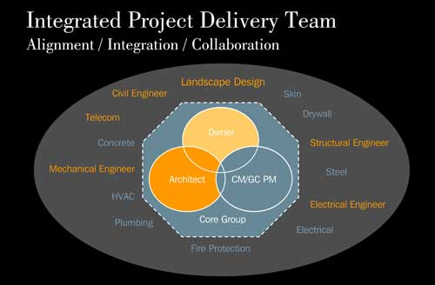
Alternative Delivery Method (MAE)
Integrated Project Delivery
  Advantages
  BIM
  Reduce Project Disputes
  Involve Specialty Contractors Early
  Well Defined Scope for All Team Players
  Open Communication, Pricing, Schedule, and Quality – Better CO Management
  Disadvantages
  Not a Familiar Delivery Method in Region
  More Risk for Bidders
  Not a Proven Delivery Method – Too Risky for this Project

Slide 17
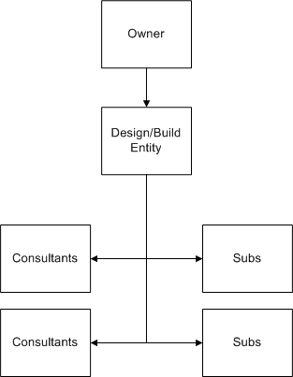
Alternative Delivery Method (MAE)
Design-Build
  Advantages
  Team Approach
  Constructability Issues Addressed Early in Design
  Better Control of Budget in Design and Construction Phase
  Disadvantages
  Would Not Accelerate Project
  No Checks and Balance
  Risk of Sacrificing Design Quality to Protect Design-Builder’s Profits

Slide 18
Alternative Delivery Method (MAE)
Design-Build MEP
  Changes have Increased MEP Trades Contracts by 17%
  Severely Impacted Coordination and Prefabrication
  Last-minute Drawings
  Eliminated All of the Float
  D/B MEP would have Cost 5% More Initially
  Advantages
  Involved Early in Design
  V/E
  Schedule Input
  Early Coordination, Procurement, and Prefabrication
  Disadvantages
  Initial Cost

Slide 19
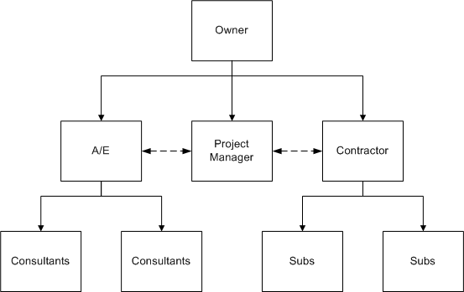
Alternative Delivery Method (MAE)
Traditional w/Early Procurement and PM
  Same Delivery Method Except for PM
  KLMK Group
  Advantages
  PM has Extensive Experience
  PM Familiar with Team Players
  Checks and Balance
  Assist Owner with Managing CO’s
  Assist with Close-out and Occupancy
  Assist with Master Planning
  Disadvantages
  Initial Cost of 1% of Total Project Cost
  May Create Hostile Environment

Slide 20
Alternative Delivery Method (MAE)
Conclusion
  PDCS Did Not Identify Best Delivery Method
  Hindsight is 20/20
  Best Alternative is a Mix of the Top 3
    PM
    D/B MEP
    IPD Principles
  Manage CO’s More Efficiently

Slide 21
Chilled Beams Cost & Schedule Impact (Mechanical)
Problem Statement
  Top 2 Goals for the Owner, A/E, and CM are Not Being Met
  1st Package of Changes (CCD 1-38)
    7 Months Delay
    Cost to Accelerate to 3 Months Delay = $2M
    Mechanical System is Impacted the Most
Goal
  Demonstrate that Chilled Beam HVAC Systems in Non-Invasive Spaces have the Potential to Lower Cost (Initial and Life-Cycle) and Accelerate the Schedule.

Slide 22
Chilled Beams Cost & Schedule Impact (Mechanical)
Current Design
VAV System with Reheat Coils on Each VAV Box
Mech. Package Accounts for 29.1% of Construction Cost
HVAC System Totals 13.9% or $79,444,970
Critical Path Largely Involves HVAC Overhead
Central Utility Plant Provides Chilled Water and Steam
Method
Research Chilled Beams
Contact Industry Experts
Size Chilled Beams
Evaluate Initial Cost
Evaluate Life-Cycle Cost
Evaluate Schedule Impact

Slide 23
Chilled Beams Cost & Schedule Impact (Mechanical)
Chilled Beam System
Emerging Technology from Europe
Few Projects in the U.S.A.
  Constitution Center in D.C.
  Yale Hospital Expansion in New Haven, CT

Slide 24
Chilled Beams Cost & Schedule Impact (Mechanical)
Chilled Beam System
Emerging Technology from Europe
Few Projects in the U.S.A.
  Constitution Center in D.C.
  Yale Hospital Expansion in New Haven, CT
Save Energy
Reduce Sizes of Ductwork, AHUs, Fans, etc.

Slide 25
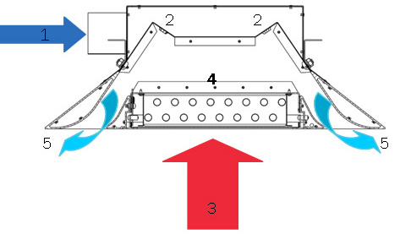
Chilled Beams Cost & Schedule Impact (Mechanical)
Chilled Beam System
Emerging Technology from Europe
Few Projects in the U.S.A.
  Constitution Center in D.C.
  Yale Hospital Expansion in New Haven, CT
Save Energy
Reduce Sizes of Ductwork, AHUs, Fans, etc.
Two Types of Chilled Beams
  Passive
  Active

Slide 26
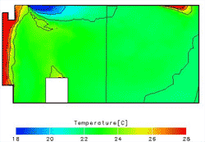
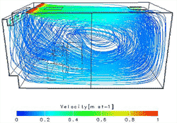
Chilled Beams Cost & Schedule Impact (Mechanical)
Chilled Beam System
Emerging Technology from Europe
Few Projects in the U.S.A.
  Constitution Center in D.C.
  Yale Hospital Expansion in New Haven, CT
Save Energy
Reduce Sizes of Ductwork, AHUs, Fans, etc.
Two Types of Chilled Beams
  Passive
  Active
Many Advantages
  Low Energy Consumption
  Space Savings
  Improved Comfort
  Easy Commissioning

Slide 27
Chilled Beams Cost & Schedule Impact (Mechanical)
Sizing the Chilled Beam System
Current VAV System will Remain in Invasive Spaces (ORs, Trauma, Exam Rooms, etc.)
Examine Typical Areas of Non-Invasive Spaces
  Offices
  Patient Rooms
Extrapolate Results to Remaining Areas
Sizing Calculations
Size Primary Air to Meet OA or Latent Requirements
Chilled Beam will be Sized to Handle Rest of Sensible Load
Assume Supply CFM on Drawings Represent Design Loads
Sizing is Based on Cooling
Heating Coil will be Required on Perimeter Spaces

Slide 28
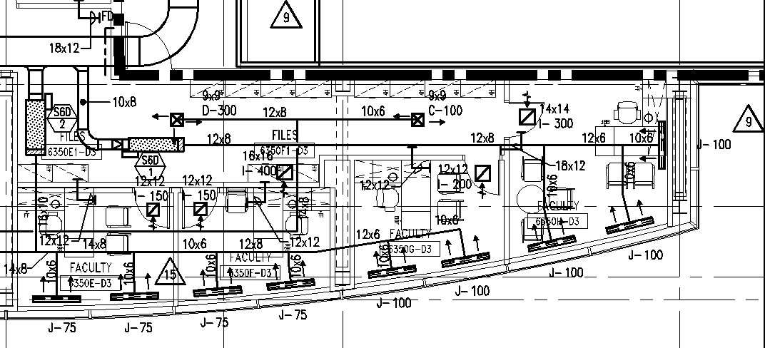
Chilled Beams Cost & Schedule Impact (Mechanical)
Sizing Example
Typ. Office Space on Level 6
VAV Box S6D-1
  Total Supply = 300 CFM
  6 Person Occupancy
  1 Room is Served by VAV
  Room Temp = 70˚F
  Supply Temp = 55˚F

Slide 29
Chilled Beams Cost & Schedule Impact (Mechanical)
1. Total Sensible Design Load = 1.08 x Total Supply CFM x (Room Temp – Supply Temp)
= 1.08 x 300 CFM x (70˚F - 55˚F)
= 4,860 BTU/hr

Slide 30
Chilled Beams Cost & Schedule Impact (Mechanical)
Total Sensible Design Load = 1.08 x Total Supply CFM x (Room Temp – Supply Temp)
= 1.08 x 300 CFM x (70˚F - 55˚F)
= 4,860 BTU/hr
2. Ventilation air required per ASHRAE 62.1 – 2007 is 25 CFM/person for patient rooms. Office spaces are not shown. To be on the conservative side, 25 CFM/person will be used for both the office and patient rooms.

Slide 31
Chilled Beams Cost & Schedule Impact (Mechanical)
Total Sensible Design Load = 1.08 x Total Supply CFM x (Room Temp – Supply Temp)
= 1.08 x 300 CFM x (70˚F - 55˚F)
= 4,860 BTU/hr
2. Ventilation air required per ASHRAE 62.1 – 2007 is 25 CFM/person for patient rooms. Office spaces are not shown. To be on the conservative side, 25 CFM/person will be used for both the office and patient rooms.
3. Ventilation Air Required = 25 CFM/person x 6 persons = 150 CFM

Slide 32
Chilled Beams Cost & Schedule Impact (Mechanical)
Total Sensible Design Load = 1.08 x Total Supply CFM x (Room Temp – Supply Temp)
= 1.08 x 300 CFM x (70˚F - 55˚F)
= 4,860 BTU/hr
2. Ventilation air required per ASHRAE 62.1 – 2007 is 25 CFM/person for patient rooms. Office spaces are not shown. To be on the conservative side, 25 CFM/person will be used for both the office and patient rooms.
3. Ventilation Air Required = 25 CFM/person x 6 persons = 150 CFM
4. Assume that ventilation air governs primary air supply right now and then check to see if it is greater than the latent load air requirement later.

Slide 33
Chilled Beams Cost & Schedule Impact (Mechanical)
Total Sensible Design Load = 1.08 x Total Supply CFM x (Room Temp – Supply Temp)
= 1.08 x 300 CFM x (70˚F - 55˚F)
= 4,860 BTU/hr
2. Ventilation air required per ASHRAE 62.1 – 2007 is 25 CFM/person for patient rooms. Office spaces are not shown. To be on the conservative side, 25 CFM/person will be used for both the office and patient rooms.
3. Ventilation Air Required = 25 CFM/person x 6 persons = 150 CFM
4. Assume that ventilation air governs primary air supply right now and then check to see if it is greater than the latent load air requirement later.
5. Sensible Cooling Capacity of Primary Air = 1.08 x Vent. Air CFM x (Room Temp – Supply Temp)
= 1.08 x 150 CFM x (70˚F - 55˚F)
= 2,430 BTU/hr

Slide 34
Chilled Beams Cost & Schedule Impact (Mechanical)
6. Sensible Cooling by Chilled Beam = Total Sensible Load – Sensible Capacity of Primary Air
= 4,860 BTU/hr – 2,430 BTU/hr
= 2,430 BTU/hr

Slide 35
Chilled Beams Cost & Schedule Impact (Mechanical)
6. Sensible Cooling by Chilled Beam = Total Sensible Load – Sensible Capacity of Primary Air
= 4,860 BTU/hr – 2,430 BTU/hr
= 2,430 BTU/hr
7. Latent load in the room can be approximated by the general rule of thumb that each person gives off 200 BTU/hr of latent load.

Slide 36
Chilled Beams Cost & Schedule Impact (Mechanical)
6. Sensible Cooling by Chilled Beam = Total Sensible Load – Sensible Capacity of Primary Air
= 4,860 BTU/hr – 2,430 BTU/hr
= 2,430 BTU/hr
7. Latent load in the room can be approximated by the general rule of thumb that each person gives off 200 BTU/hr of latent load.
8. Latent Load = 200 BTU/hr/person x 6 person = 1,200 BTU/hr

Slide 37
Chilled Beams Cost & Schedule Impact (Mechanical)
6. Sensible Cooling by Chilled Beam = Total Sensible Load – Sensible Capacity of Primary Air
= 4,860 BTU/hr – 2,430 BTU/hr
= 2,430 BTU/hr
7. Latent load in the room can be approximated by the general rule of thumb that each person gives off 200 BTU/hr of latent load.
8. Latent Load = 200 BTU/hr/person x 6 person = 1,200 BTU/hr
9. Latent Cooling Capacity of Primary Air = 4,840 x Vent. Air CFM x (W_{Room} – W_{Primary})
= 4,840 x 150 CFM (0.009 – 0.007)
= 1,452 BTU/hr

Slide 38
Chilled Beams Cost & Schedule Impact (Mechanical)
6. Sensible Cooling by Chilled Beam = Total Sensible Load – Sensible Capacity of Primary Air
= 4,860 BTU/hr – 2,430 BTU/hr
= 2,430 BTU/hr
7. Latent load in the room can be approximated by the general rule of thumb that each person gives off 200 BTU/hr of latent load.
8. Latent Load = 200 BTU/hr/person x 6 person = 1,200 BTU/hr
9. Latent Cooling Capacity of Primary Air = 4,840 x Vent. Air CFM x (W_{Room} – W_{Primary})
= 4,840 x 150 CFM (0.009 – 0.007)
= 1,452 BTU/hr
10. The latent cooling capacity of primary air is greater than the latent load. Therefore, the ventilation air is adequate in supporting the latent load for the zone.

Slide 39
Chilled Beams Cost & Schedule Impact (Mechanical)
11. On average, a chilled beam can produce 1,000 BTU/hr/ft of sensible cooling capacity.

Slide 40
Chilled Beams Cost & Schedule Impact (Mechanical)
11. On average, a chilled beam can produce 1,000 BTU/hr/ft of sensible cooling capacity.
12. Chilled Beam Size = 2,430 BTU/hr ÷ 1,000 BTU/hr/ft = 2.43 ft Chilled Beam ≈ 3 ft Chilled Beam

Slide 41
Chilled Beams Cost & Schedule Impact (Mechanical)
11. On average, a chilled beam can produce 1,000 BTU/hr/ft of sensible cooling capacity.
12. Chilled Beam Size = 2,430 BTU/hr ÷ 1,000 BTU/hr/ft = 2.43 ft Chilled Beam ≈ 3 ft Chilled Beam
13. Primary Air Reduction = 1 – (Primary Air CFM ÷ Total Current Supply CFM)
= 1 – (150 CFM ÷ 300 CFM)
= 50%

Slide 42
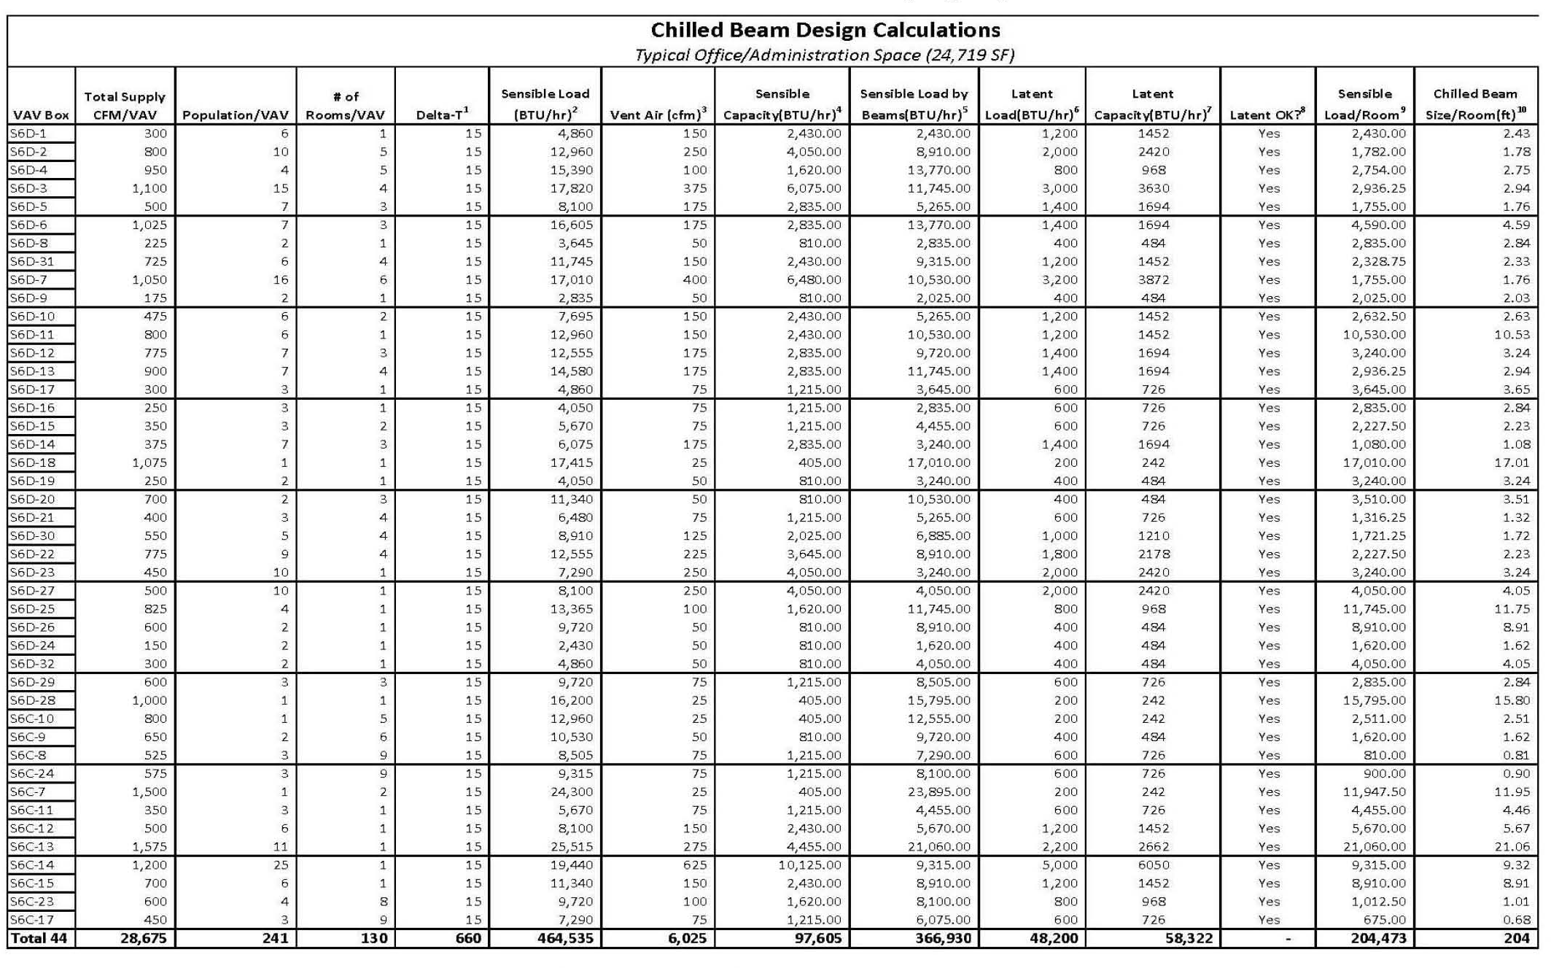
Chilled Beams Cost & Schedule Impact (Mechanical)
Typ. Office Space
Primary Air Reduction = 79%
Average Chilled Beam Size per Room = 5 ft
Total Cost of VAVs for Typical Area = $15,078 = $0.61/SF
Total Cost of Chilled Beams for Typical Area = $102,760 = $4.16/SF
Percent Increase of Chilled Beams over VAV Boxes = 682%

Slide 43
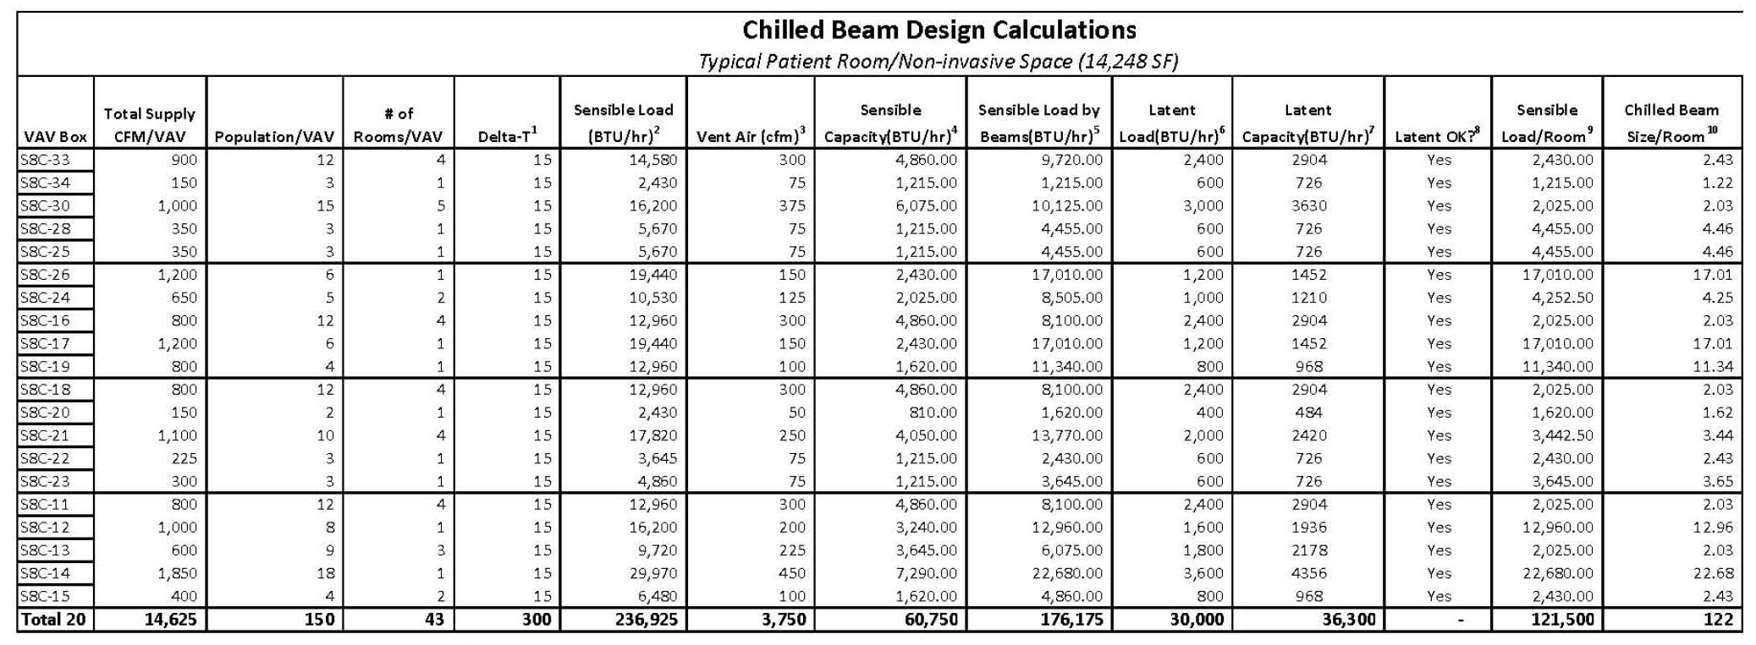
Chilled Beams Cost & Schedule Impact (Mechanical)
Typ. Office Space
Primary Air Reduction = 79%
Average Chilled Beam Size per Room = 5 ft
Total Cost of VAVs for Typical Area = $15,078 = $0.61/SF
Total Cost of Chilled Beams for Typical Area = $102,760 = $4.16/SF
Percent Increase of Chilled Beams over VAV Boxes = 682%
Typ. Patient Rooms
Primary Air Reduction = 74%
Average Chilled Beam Size per Room = 6 ft
Total Cost of VAVs for Typical Area = $6,854 = $0.48/SF
Total Cost of Chilled Beams for Typical Area = $49,280 = $3.46/SF
Percent Increase of Chilled Beams over VAV Boxes = 719%

Slide 44
Chilled Beams Cost & Schedule Impact (Mechanical)
Total Project HVAC Cost
Description | Material | Labor | Total | % Total
Variable Frequency Drives | $1,019,375 | $168,125 | $1,187,500 | 1.5
Hydronic Pump Package | $159,283 | $85,702 | $244,985 | 0.3
Condensate Pump Sets | $31,035 | $10,813 | $41,848 | 0.1
Steam Specialties | $537,011 | $388,896 | $925,907 | 1.2
VAV Boxes & Terminals | $760,743 | $267,290 | $1,028,033 | 1.3
Fans & Accessories | $503,782 | $95,602 | $599,384 | 0.8
Clean Steam Generators | $134,086 | $29,446 | $163,520 | 0.2
Duct Humidifiers | $41,002 | $8,398 | $49,400 | 0.1
Custom AHUs | $5,772,000 | $1,628,000 | $7,400,000 | 9.3
Ductwork | $15,368,723 | $23,053,085 | $38,421,808 | 48.4
Controls | $3,591,315 | $1,933,785 | $5,525,100 | 7.0
Mechanical Insulation | $1,320,602 | $1,980,904 | $3,301,506 | 4.2
Test & Balance | - | $725,000 | $725,000 | 0.9
Chilled Water Piping | $3,366,041 | $1,891,780 | $5,257,821 | 6.6
Heating Hot Water Piping | $4,883,147 | $6,600,553 | $11,483,700 | 14.5
Steam & Condensate Piping | $1,312,869 | $1,776,589 | $3,089,458 | 3.9
Grand Total | $38,801,014 | $40,643,956 | $79,444,970 | 100
Cost Impact
Total HVAC Cost
Break-down Material and Labor

Slide 45
Chilled Beams Cost & Schedule Impact (Mechanical)
Non-Invasive HVAC Cost
Description | Material | Labor | Total | % Total
Variable Frequency Drives | $509,688 | $84,063 | $593,750 | 1.5
Hydronic Pump Package | $79,642 | $42,851 | $122,493 | 0.3
Condensate Pump Sets | $15,518 | $5,407 | $20,924 | 0.1
Steam Specialties | $268,506 | $194,448 | $462,965 | 1.2
VAV Boxes & Terminals | $380,372 | $133,645 | $514,017 | 1.3
Fans & Accessories | $251,891 | $47,801 | $299,692 | 0.8
Clean Steam Generators | $67,043 | $14,723 | $81,760 | 0.2
Duct Humidifiers | $20,501 | $4,199 | $24,700 | 0.1
Custom AHUs | $2,886,000 | $814,000 | $3,700,000 | 9.3
Ductwork | $7,684,362 | $11,526,543 | $19,210,904 | 48.4
Controls | $1,795,658 | $966,893 | $2,762,550 | 7.0
Mechanical Insulation | $660,301 | $990,452 | $1,650,753 | 4.2
Test & Balance | - | $362,500 | $362,500 | 0.9
Chilled Water Piping | $1,683,021 | $945,890 | $2,628,911 | 6.6
Heating Hot Water Piping | $2,441,574 | $3,300,277 | $5,741,850 | 14.5
Steam & Condensate Piping | $656,435 | $888,295 | $1,544,729 | 3.9
Grand Total | $19,400,507 | $20,321,978 | $39,722,485 | 100
Cost Impact
Total HVAC Cost
Break-down Material and Labor
Non-Invasive Space HVAC Cost
  60% of Total Building Area Non-Invasive Space
  Assume 25% Extra Cost for Invasive Space
  50% of Total HVAC Cost is for Non-Invasive Space

Slide 46
Material Cost Savings = $7,684,362 x 0.5 = $3,842,181
Labor Cost Savings = $11,526,543 x 0.7 = $8,068,580
Total Ductwork Cost = $11,910,761
Chilled Beams Cost & Schedule Impact (Mechanical)
Ductwork
75% Reduction in Cross-Section
50% Reduction in Area => Material
30% Savings in Labor
Material Cost Savings = $7,684,362 x 0.5 = $3,842,181
Labor Cost Savings = $11,526,543 x 0.7 = $8,068,580
Total Ductwork Cost = $11,910,761
10”
5”
Cross
Section =100 in²
Cross
Section =25 in²
10”
5”

Slide 47
Material Cost Savings = $7,684,362 x 0.5 = $3,842,181
Labor Cost Savings = $11,526,543 x 0.7 = $8,068,580
Total Ductwork Cost = $11,910,761
Chilled Beams Cost & Schedule Impact (Mechanical)
AHUs, Fans, Variable Frequency Drives
75% Reduction in Capacity
P&K Estimate
60% Material Savings
40% Labor Savings
AHU Material Cost Savings = $2,886,000 x 0.4 = $1,154,400
AHU Labor Cost Savings = $814,000 x 0.6 = $488,400
Total AHU Cost = $1,642,800
Fans Material Cost Savings = $251,891 x 0.4 = $100,756
Fans Labor Cost Savings = $47,801 x 0.6% = $28,680
Total Fans Cost = $129,436
VFD Material Cost Savings = $509,688 x 0.4 = $203,875
VFD Labor Cost Savings = 84,063 x 0.6 = $50,438
Total VFD Cost = $254,313

Slide 48
Material Cost Savings = $7,684,362 x 0.5 = $3,842,181
Labor Cost Savings = $11,526,543 x 0.7 = $8,068,580
Total Ductwork Cost = $11,910,761
Chilled Beams Cost & Schedule Impact (Mechanical)
Chilled Water Piping
VAV Box Reheat Coil Piping
  $71.77/ft.
Analyze a Typ. Space
2-Pipe System in Interior (Cooling Only)
4-Pipe System around Exterior (Cooling and Heating)
Total Pipe per Area = 2,994 lf ÷ 14,364 SF = 0.21 lf/SF
Non-invasive Area = 1.6M SF x 60% = 960,000 SF
Cost of Chilled Water Pipe to Chilled Beam = 960,000 SF x 0.21 lf/SF x $71.77/lf
= $14,468,832
Add Chilled Water Pipe from Central Utility Plant to AHUs
Total Cost of Chilled Water Piping = $14,468,832 + $2,628,911 = $17,097,743

Slide 49
Material Cost Savings = $7,684,362 x 0.5 = $3,842,181
Labor Cost Savings = $11,526,543 x 0.7 = $8,068,580
Total Ductwork Cost = $11,910,761
Chilled Beams Cost & Schedule Impact (Mechanical)
Chilled Beams
Substitute Chilled Beams for VAV Boxes
VAV Box Unit Cost = $1,028,033 ÷ 3,000 units = $342.68 (includes diffusers)
Average Cost of Chilled Beam = $140/ft (Source: Pierces Associates)
Average Cost of Installing Chilled Beam = $140/ft (Source: Pierces Associates)
Total Cost of Chilled Beams = 960,000 SF x $3.81/SF = $3,657,600
 | Office Rooms | Patient Rooms | Average
VAV Boxes | $0.61/SF | $0.48/SF | $0.55/SF
Chilled Beams | $4.16/SF | $3.46/SF | $3.81/SF
% Increase | 682% | 721% | 693%

Slide 50
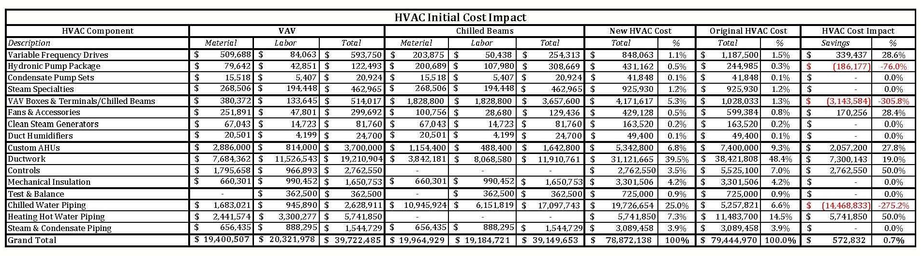
Material Cost Savings = $7,684,362 x 0.5 = $3,842,181
Labor Cost Savings = $11,526,543 x 0.7 = $8,068,580
Total Ductwork Cost = $11,910,761
Chilled Beams Cost & Schedule Impact (Mechanical)
Chilled Beam HVAC System Initial Cost
Add VAV and Chilled Beam Cost Together
Total Savings in HVAC Cost = $572,832
Most of the Savings came from Labor
Significant Savings in Ductwork
Savings Offset by Increase Cost of Piping

Slide 51
Material Cost Savings = $7,684,362 x 0.5 = $3,842,181
Labor Cost Savings = $11,526,543 x 0.7 = $8,068,580
Total Ductwork Cost = $11,910,761
Chilled Beams Cost & Schedule Impact (Mechanical)
Building Façade Cost Impact
Floor-Floor Average Height = 15’
Ceiling Tile Located 8’-10’ AFF
Ceiling Plenum Ranges 6’-4” to 4’-4”
Typ. Girder is W21x57
Critical Clear Space 2’-7”
Reduce Clear Space by 50%
Total amount of façade SF reduced = 1’-4”/floor x 15 floors x 2,515’ x 0.6 = 30,180 SF
Total amount of Precast SF reduced = 30,180 SF x 0.43 = 12,977 SF
Total amount of Curtain Wall SF reduced = 30,180 SF x 0.57 = 17,203 SF
Total Savings in Precast = 12,977 SF x $45.77/SF = $593,957
Total Savings in Curtain Wall = 17,203 SF x $102.18/SF = $1,757,803

Slide 52
Material Cost Savings = $7,684,362 x 0.5 = $3,842,181
Labor Cost Savings = $11,526,543 x 0.7 = $8,068,580
Total Ductwork Cost = $11,910,761
Chilled Beams Cost & Schedule Impact (Mechanical)
Structural Steel Cost Impact
Columns can be Reduced by 1’-4”
219 Columns per Floor
Average Weight = 91.6 lbs/ft.
Total Reduction in Steel = 219 columns x 91.6 lbs/ft/column x 1’-4”/floor x 15 floors x 0.6
= 120.3 tons
Total Savings in Structural Steel = 120.3 tons x $2,352/ton = $283,092

Slide 53
Material Cost Savings = $7,684,362 x 0.5 = $3,842,181
Labor Cost Savings = $11,526,543 x 0.7 = $8,068,580
Total Ductwork Cost = $11,910,761
Chilled Beams Cost & Schedule Impact (Mechanical)
5 Year Savings for 15% Efficiency = $1,497,176
5 Year Savings for 25% Efficiency = $2,495,294
5 Year Savings for 35% Efficiency = $3,493,411
10 Year Savings for 15% Efficiency = $3,232,814
10 Year Savings for 25% Efficiency = $5,388,023
10 Year Savings for 35% Efficiency = $7,543,233
20 Year Savings for 15% Efficiency = $7,577,446
20 Year Savings for 25% Efficiency = $12,629,076
20 Year Savings for 35% Efficiency = $17,680,706
30 Year Savings for 15% Efficiency = $13,416,267
30 Year Savings for 25% Efficiency = $22,360,445
30 Year Savings for 35% Efficiency = $31,304,624
Energy Savings
Estimated Annual HVAC Energy Cost = $2.35/SF = $3,760,000
50% of Load for Non-Invasive Space => 50% of Energy Cost
Detailed Energy Model Needed to Predict Energy Savings
  Constitution Center Saved 23.8%
  Industry Experts Predict 20-35% Savings
3 Scenarios – 15%, 25%, and 35% Savings
Assume 3% Inflation

Slide 54
Material Cost Savings = $7,684,362 x 0.5 = $3,842,181
Labor Cost Savings = $11,526,543 x 0.7 = $8,068,580
Total Ductwork Cost = $11,910,761
Chilled Beams Cost & Schedule Impact (Mechanical)
Space Savings
Reduce Mechanical Shaft Space by 50%
Reduce Mechanical Room Space by 25%
NCB Generates a Yearly Revenue of $983/SF
Total Space Saving by Mechanical Shaft = 9 x 8’ x 26’ x 15 floors x 0.5 x 0.6 = 8,434 SF
Total Revenue Generated by Mechanical Shaft = 8,434 SF x $983/SF/Year = $8,280,792/Year
Total Space Saving by Mechanical Room = 80,118 SF x 0.25 x 0.5 = 10,015 SF
Total Revenue Generated by Mechanical Room = 10,015 SF x $983/SF/Year = $9,844,745/Year
Total Revenue from Space Savings = $8,280,792/Year + $9,844,745/Year = $18,125,537/Year

Slide 55
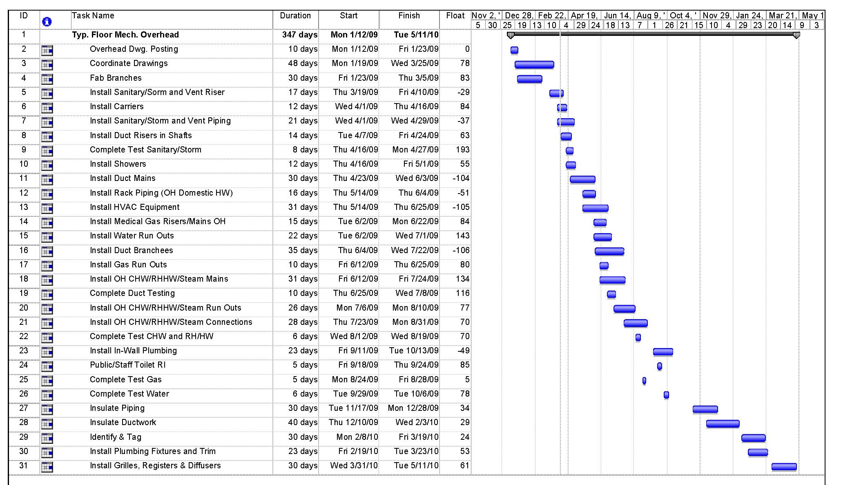
Material Cost Savings = $7,684,362 x 0.5 = $3,842,181
Labor Cost Savings = $11,526,543 x 0.7 = $8,068,580
Total Ductwork Cost = $11,910,761
Baseline Typ. Floor Mech. Overhead
Chilled Beams Cost & Schedule Impact (Mechanical)
Schedule Impact
Analyze Typ. Floor
Baseline Schedule
Note the Amount of Float for Each Activity

Slide 56
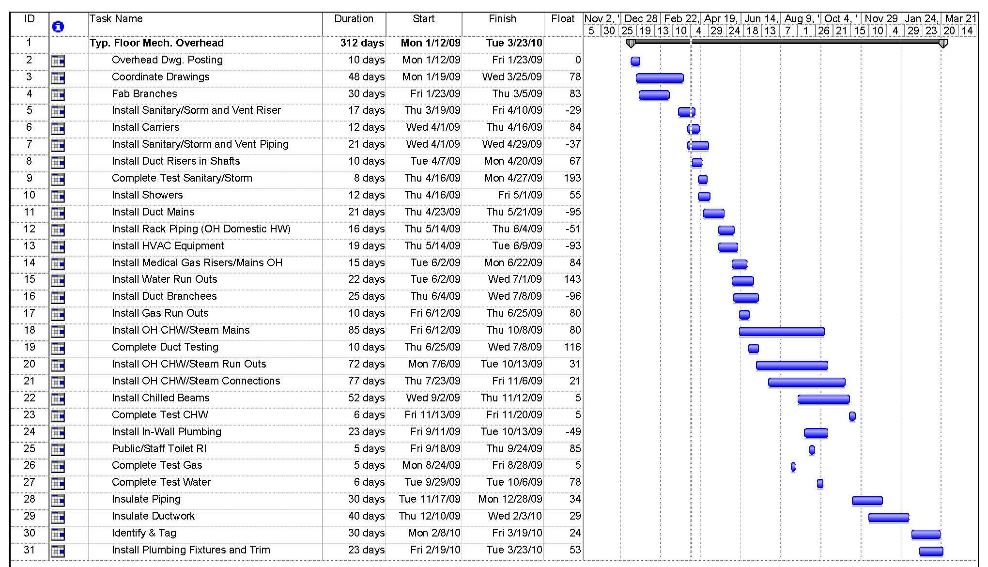
Material Cost Savings = $7,684,362 x 0.5 = $3,842,181
Labor Cost Savings = $11,526,543 x 0.7 = $8,068,580
Total Ductwork Cost = $11,910,761
Chilled Beam Typ. Floor Mech. Overhead
Chilled Beams Cost & Schedule Impact (Mechanical)
Schedule Impact
Analyze Typ. Floor
Baseline Schedule
Note the Amount of Float for Each Activity
Install Duct Risers in Shafts – Decrease by 30%
Install Duct Mains – Decrease by 30%
Install HVAC Equipment – Decrease by 40%
Install Duct Branches – Decrease by 30%
Install OH CHW/RHHW/Steam Mains - Delete Reheat Hot Water (RHHW) and add 275%
Install OH CHW/RHHW/Steam RO – Delete Reheat Hot Water and add 275%
Install OH CHW/RHHW/Steam Connections - Delete Reheat Hot Water and add 275%
Install Grilles, Registers & Diffusers – Delete and add Install Chilled Beams

Slide 57
Material Cost Savings = $7,684,362 x 0.5 = $3,842,181
Labor Cost Savings = $11,526,543 x 0.7 = $8,068,580
Total Ductwork Cost = $11,910,761
Chilled Beam Typ. Floor Mech. Overhead
Chilled Beams Cost & Schedule Impact (Mechanical)
Schedule Impact
Activities that are accelerated are Ductwork and HVAC Equipment
  Critical Path
  Accelerates Floor by 31 Working Days
Activities that Extend the Duration (Piping) are Absorbed in the Float
Does Not Accelerate the Overall Project Significantly
Mechanical Overhead is Taken Off the Critical Path
  Reduce Impact of Changes

Slide 58
Material Cost Savings = $7,684,362 x 0.5 = $3,842,181
Labor Cost Savings = $11,526,543 x 0.7 = $8,068,580
Total Ductwork Cost = $11,910,761
Chilled Beams Cost & Schedule Impact (Mechanical)
Initial Savings
HVAC Savings = $572,832
Façade Savings = $2,351,760
Steel Savings = $283,092
Total = $3,207,684
Energy Savings
5 Year = $1.5M – $3.5M
10 Year = $3.2M – $7.5M
20 Year = $7.6M - $17.7M
30 Year = $13.4M - $31.3M
Revenue
Total Yearly Revenue Generated = $18,125,537
Conclusion
Viable Alternative to VAV
Could Have Taken Mech. System Off Critical Path
Project Worked Well for Chilled Beams
  48% of HVAC Cost was Ductwork
  Central Utility Plant
  Small Room Sizes = 1 Chilled Beam/Room
  High Energy Cost
  High Revenue per Area
Many Assumptions
  More Research and Data Needed

Slide 59
Case Study: Concrete Over-pour on Decks Due to Steel Deflection (Structural)
Problem Statement
Note CP-4
Contractor Poured Concrete to FF Elevation
Did Not Check Thickness (Wet-Stick)
Some Deflections of 2” Mid-Bay
Contractor Responsible for all Over-pour
Potential Problems
  Impact MEP Coordination
  Overload the Floor
  Floor Installation
  Door Jams

Slide 60
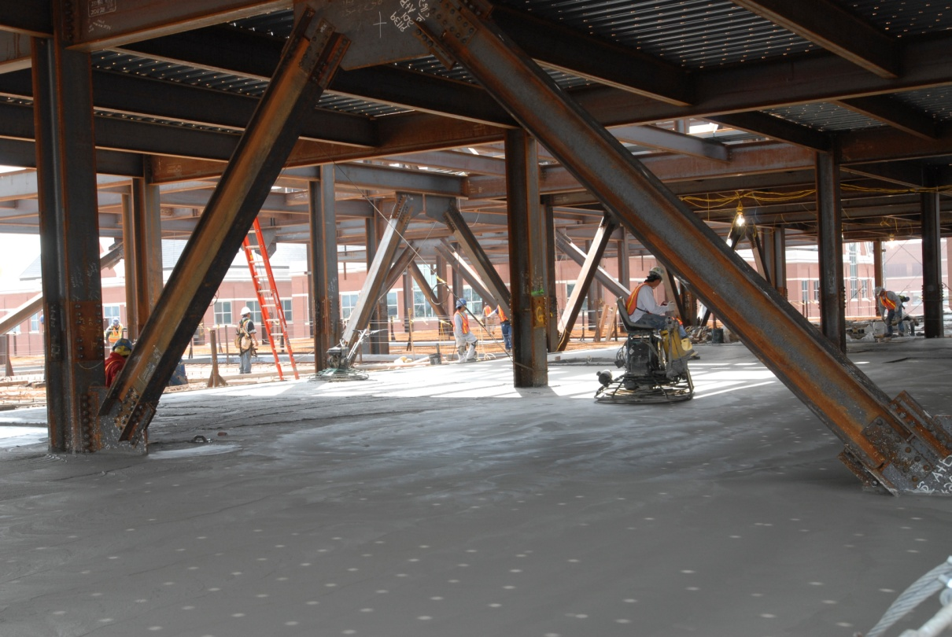
Case Study: Concrete Over-pour on Decks Due to Steel Deflection (Structural Breadth)
Goal
Examine How the Concrete Over-pour Issue was Addressed in the Design, Bid, and Construction Phases
Calculate Typical Bay Deflections
Strategy for Addressing this Constructability Challenge on Future Projects

Slide 61
Case Study: Concrete Over-pour on Decks Due to Steel Deflection (Structural Breadth)
Design Phase
No FL Requirement => Note CP-4
FF Requirement = 25 (1/4” Over 10’)
Steel Deflection Difficult to Predict
Camber Girders (Loads Not Predictable)
Camber Beams (Loads Predictable)
Engineer Carried 7 PSF for Concrete Over-pour in Construction Load

Slide 62
Case Study: Concrete Over-pour on Decks Due to Steel Deflection (Structural Breadth)
Design Phase
Construction Load 85 PSF (Includes 7 PSF for Over-pour)
28’-8”
W16x26 c = ¾”
EQ.
W16x26 c = ¾”
EQ.
28’-8”
W21x57 c = 0”
W16x26 c = ¾”
W21x57 c = 0”
EQ.
W16x26 c = ¾”
EQ.
W16x26 c = ¾”

Slide 63
Case Study: Concrete Over-pour on Decks Due to Steel Deflection (Structural Breadth)
Simply Supported Beam – Uniformly Distributed Load
Design Phase
Construction Load 85 PSF (Includes 7 PSF for Over-pour)
Beam Max Deflection = 1.41” – 0.75” (Camber) = 0.66”
85 PSF
W16x26 c = ¾”
28’-8”
R
R
Max Deflection (Midspan) = 1.41”
Up-size beam – W18x35
  Deflection = 0.83
  Difference = 0.58”
  Significant cost – most common steel member

Slide 64
Case Study: Concrete Over-pour on Decks Due to Steel Deflection (Structural Breadth)
Design Phase
Construction Load 85 PSF (Includes 7 PSF for Over-pour)
Beam Max Deflection = 1.41” – 0.75” (Camber) = 0.66”
∆ = 0.66”
∆ = 0.66”

Slide 65
Case Study: Concrete Over-pour on Decks Due to Steel Deflection (Structural Breadth)
Simply Supported Girder – 2 Equal Concentrated Loads Symmetrically Placed
Design Phase
Construction Load 85 PSF (Includes 7 PSF for Over-pour)
Beam Max Deflection = 1.41” – 0.75” (Camber) = 0.66”
Girder Max Deflection = 0.99”
P₁ = 23.3k
P₂ = 23.3k
W21x57 c = 0”
EQ.
EQ.
EQ.
28’-8”
Max Deflection (Midspan) = 0.99”
Up-size beam – W24x55
  Deflection = 0.85
  Difference = 0.15”
  Not Worth Reducing Ceiling Plenum/Height

Slide 66
Case Study: Concrete Over-pour on Decks Due to Steel Deflection (Structural Breadth)
Design Phase
Construction Load 85 PSF (Includes 7 PSF for Over-pour)
Beam Max Deflection = 1.41” – 0.75” (Camber) = 0.66”
Girder Max Deflection = 0.99”
∆ = 0.99”
∆ = 0.99”

Slide 67
Case Study: Concrete Over-pour on Decks Due to Steel Deflection (Structural Breadth)
Design Phase
Construction Load 85 PSF (Includes 7 PSF for Over-pour)
Beam Max Deflection = 1.41” – 0.75” (Camber) = 0.66”
Girder Max Deflection = 0.99”
Total Mid-Bay Deflection = 0.66” + 0.99” = 1.65”
∆Total = 1.65”

Slide 68
Case Study: Concrete Over-pour on Decks Due to Steel Deflection (Structural Breadth)
Design Phase
Construction Load 85 PSF (Includes 7 PSF for Over-pour)
Beam Max Deflection = 1.41” – 0.75” (Camber) = 0.66”
Girder Max Deflection = 0.99”
Total Mid-Bay Deflection = 0.66” + 0.99” = 1.65”
Total Volume = 2.09 CY
Load = 10.3 PSF
Assume Total Volume Spread Over Entire Area of Bay
56.5ft³ / (28.667’)² = 0.07’ = 7/8”
Total SF of Building = 1.5M
Total Concrete Over-Pour = 1,500,000 SF x 0.07’ = 103,128 ft³ = 3,820 CY
∆Total = 1.65”

Slide 69
Case Study: Concrete Over-pour on Decks Due to Steel Deflection (Structural Breadth)
Bid Phase
Clark/Banks Alerted Sub of Note CP-4
Never Contacted or Asked Question about Anticipated Deflection
Assumed 10% Extra Concrete
Carried an Allowance of $100,000 for Reshore and Flash Patching

Slide 70
Case Study: Concrete Over-pour on Decks Due to Steel Deflection (Structural Breadth)
Construction Phase
Clark/Banks held Pre-Con Meeting with Concrete Sub
  Structural Engineer Did Not Attend
3 Options to Address Deflection
  Shore Steel
  Pour to Thickness then Flash Patch
  Pour to Level and Pay for Extra Concrete
1,200 CY of Over-pour = $100,000
Used Reshore and Flash Patching Allowance to Cover Cost
Typical Deflection was 1-1/2” Mid-Bay

Slide 71
Case Study: Concrete Over-pour on Decks Due to Steel Deflection (Structural Breadth)
Conclusion
FF, FL, or Notes Similar to CP-4 Should be Clearly Called Out on DWGs and Specs
CM Should Contact Structural Engineer for Expected Deflections
Carry an Allowance for Over-pour
Buildings with Strict FF and FL Requirements Should Consult CM for Constructability
Survey Deflections
Check Camber in Shop and Field
Allow Deflection in MEP Coordination
Integrated Team Approach would be Very Helpful

Slide 72
Conclusions
Alternative Delivery Method
A traditional delivery method with early procurement, a project manager, integrated project delivery principles, and design-build MEP contractors would have reduced the risk of changes and managed the rest more efficiently.
Chilled Beams Cost & Schedule Impact
The Chilled Beam HVAC system used in non-invasive spaces could save $3,207,684 initially and an additional $13.4 M - $31.3 M over a 30 year life-cycle. It would also allow JHH to generate an additional income of $18,125,537 per year. This would take the mechanical overhead off the critical path of the building schedule. This system would be able to absorb many of the changes and delays encountered thus far on the NCB project.
Case Study: Concrete Over-pour on Decks Due to Steel Deflection
A failure to communicate early in the design, bid, and construction phases put the concrete contractor at financial risk. The NCB project had a strict levelness specification that required the contractor to over-pour the decks. The result was 1,200 CY of extra concrete that amounted to $100,000 of exposure to the concrete contractor. Further projects can avoid this problem by working with the structural engineer to determine the expected deflections. An allowance should be carried by the contractor to avoid the financial risk associated with this problem.

Slide 73
Acknowledgements
Clark Construction Group
Mike Hartman
Joe Salerno
Marty McMahon
Jim Salvino
Jim Kinkead
Katie Tworney
Robin Givens
John Bond
Brian Flegel
Lynore Arkin-Yetter
Steve Dare
Penn State University
Dr. Michael Horman
Dr. John Messner
Dr. David Riley
Dr. Moses Ling
Dr. Linda Hanagan
MC Dean
Bill Knot
TROX USA
Ken Loudermilk
Chris Lawrence
United Sheet Metal
Mike Topper
DADANCO
Bill Rafferty
BR+A
Mark Octeau
Pierce Associates, Inc.
Dan Donaghy
KLMK Group, LLC
Curtin Skolnick
SmithGroup
Dave Varner
Thornton Tomasetti
Zach Kates
JHH Facility Management
Howard Reel
Bob Singer
Poole & Kent
Donald Campbell
Turner Construction
Jim Faust

Slide 74

Questions

